Slide 1
Employee Data Attrition Analysis
M M Mithun

Slide 2
Overview
The dataset contains information about employees, including demographic details, job-related factors, and attrition status.
Features include age, gender, job level, department, business travel frequency, distance from home, education, job satisfaction, work-life balance, etc.
The target variable is "Attrition," indicating whether an employee has left the company (Yes) or not (No).

Slide 3
Key Insights
Attrition is higher among employees who travel frequently for business.
Certain departments have higher attrition rates compared to others.
Attrition varies across different education fields and genders.
Employees with lower job levels tend to have higher attrition rates.
Work-life balance and job satisfaction significantly influence attrition.
Some correlations indicate potential areas for intervention, such as the negative correlation between job satisfaction and attrition.

Slide 4
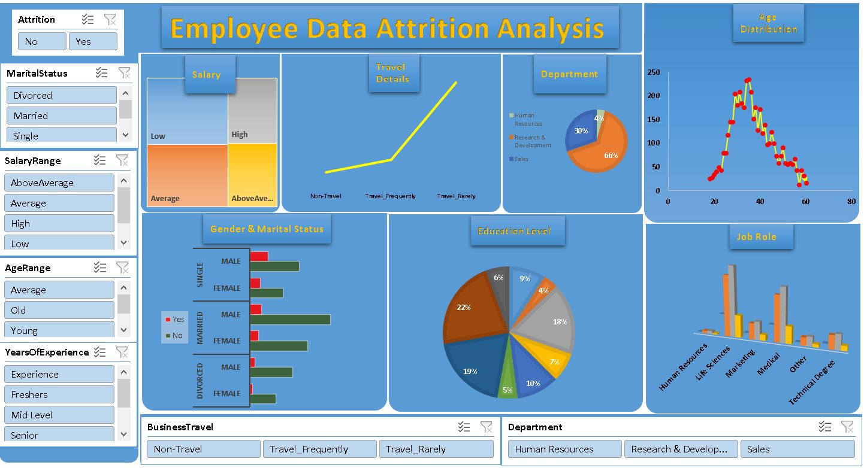
Dashboard

Slide 5
Recommendations for Employee Retention
Implement initiatives to improve work-life balance, such as flexible work hours or remote work options.
Enhance job satisfaction through recognition programs, career development opportunities, and feedback mechanisms.
Provide support and resources for employees who frequently travel for business.
Conduct department-specific interventions to address high attrition rates in certain departments.
Monitor and address issues related to gender disparities in attrition rates.

Slide 6
Thank You

